Slide 1
AWS Serverless
& Terraform
Training

Slide 2
Agenda
https://docs.google.com/document/d/1Gvul64DXLfiMdiwK0CLA94_1KIXRywKBhn7uew43QJM/edit?usp=sharing

Slide 3
Training Format
Concepts
Hands-on exercises
Assignments
Interactive

Slide 4
Timing
Start time at 10 pm
Break 12 am to 12.30 am
End at 2 pm

Slide 5
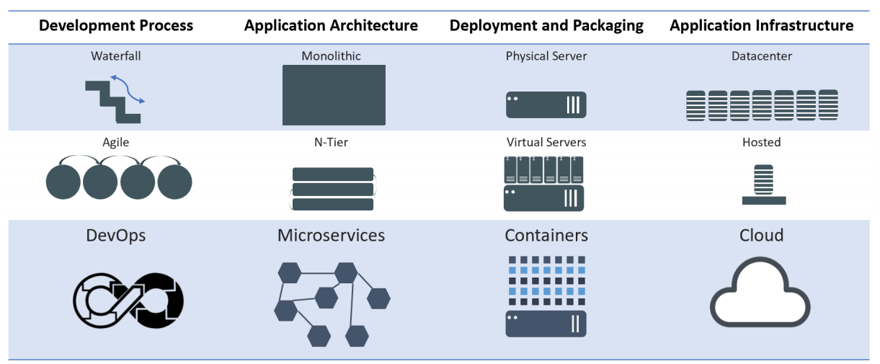
Evolution of Computing

Slide 6
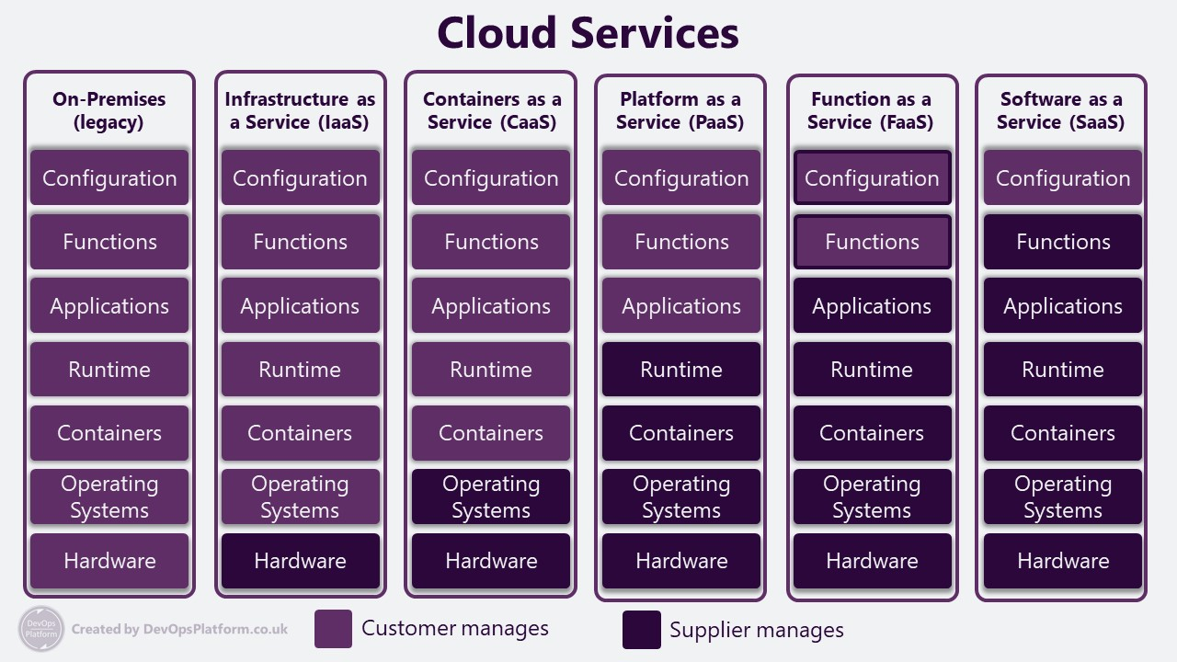

Slide 7
Serverless Computing
Serverless computing is a method of providing backend services on an as-used basis.
A serverless provider allows users to write and deploy code without the hassle of worrying about the underlying infrastructure.
A company that gets backend services from a serverless vendor is charged based on their computation and do not have to reserve and pay for a fixed amount of bandwidth or number of servers, as the service is auto-scaling.
Note that despite the name serverless, physical servers are still used but developers do not need to be aware of them.

Slide 8
advantages of serverless computing
Lower costs - Serverless computing is generally very cost-effective, as traditional cloud providers of backend services (server allocation) often result in the user paying for unused space or idle CPU time.
Simplified scalability - Developers using serverless architecture don’t have to worry about policies to scale up their code. The serverless vendor handles all of the scaling on demand.
Simplified backend code - With FaaS, developers can create simple functions that independently perform a single purpose, like making an API call.
Quicker turnaround - Serverless architecture can significantly cut time to market. Instead of needing a complicated deploy process to roll out bug fixes and new features, developers can add and modify code on a piecemeal basis.

Slide 9
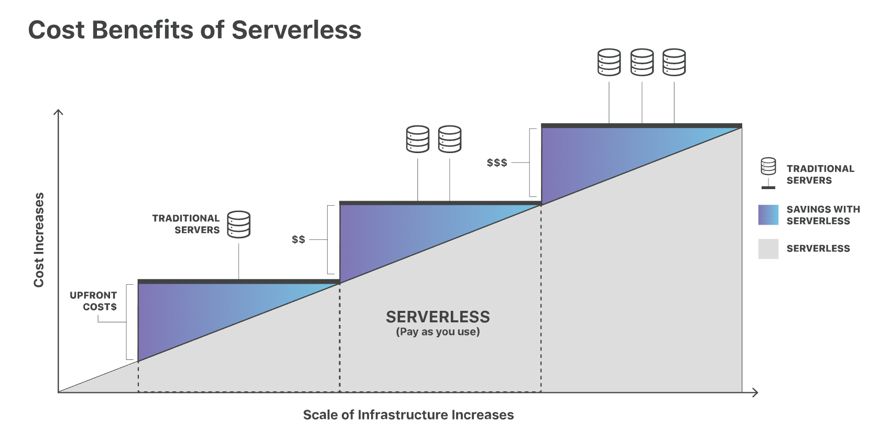
https://www.cloudflare.com/learning/serverless/what-is-serverless/

Slide 10
Serverless on AWS
Build and run applications without thinking about servers
AWS offers technologies for running code, managing data, and integrating applications, all without managing servers.
Serverless technologies feature automatic scaling, built-in high availability, and a pay-for-use billing model to increase agility and optimize costs.

Slide 11
Serverless on AWS
These technologies also eliminate infrastructure management tasks like capacity provisioning and patching, so you can focus on writing code that serves your customers.
Serverless applications start with AWS Lambda, an event-driven compute service natively integrated with over 200 AWS services and software as a service (SaaS) applications.

Slide 12
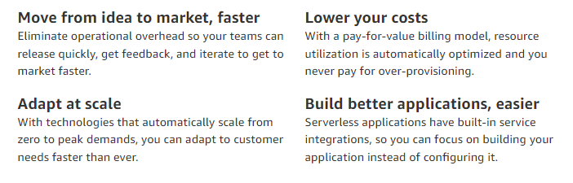
Serverless on AWS

Slide 13
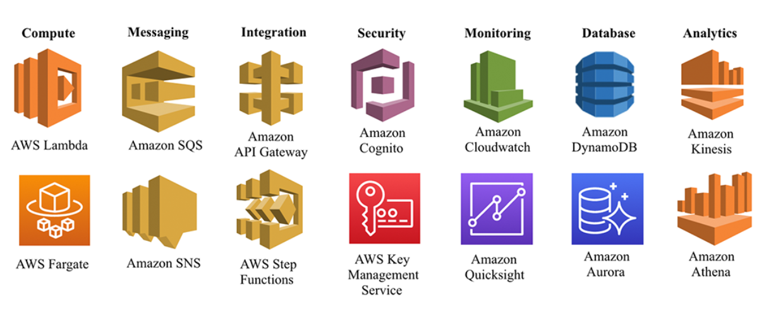
Serverless services on AWS

Slide 14
AWS Serverless Services - Quick Overview for Slides
1️⃣ Compute
AWS Lambda – Run code without managing servers. Supports multiple languages and integrates with many AWS services.
2️⃣ API & Edge
Amazon API Gateway – Create, manage, and secure RESTful and WebSocket APIs.
AWS App Runner – Deploy and run web applications and APIs without managing infrastructure.
AWS CloudFront – Global content delivery network (CDN) for low-latency content delivery.

Slide 15
AWS Serverless Services - Quick Overview for Slides
3️⃣ Storage
Amazon S3 – Scalable object storage for files, backups, and data lakes.
Amazon EFS – Serverless file system for scalable and shared access.
4️⃣ Databases
Amazon DynamoDB – Fully managed NoSQL database with single-digit millisecond latency.
Amazon Aurora Serverless – Auto-scaling relational database (MySQL/PostgreSQL compatible).

Slide 16
AWS Serverless Services - Quick Overview for Slides
5️⃣ Messaging & Event-Driven Services
Amazon SQS (Simple Queue Service) – Message queuing for decoupling microservices.
Amazon SNS (Simple Notification Service) – Pub/Sub messaging for notifications and event distribution.
Amazon EventBridge – Serverless event bus for event-driven applications and integrations.
AWS Step Functions – Serverless orchestration to coordinate workflows between AWS services.
7️⃣ Security & Identity
AWS IAM – Identity and access management for users and services.
AWS Secrets Manager – Securely store and manage API keys, credentials, and secrets.

Slide 17
AWS Serverless Services - Quick Overview for Slides
6️⃣ Analytics & ML
AWS Kinesis – Real-time data streaming for analytics and machine learning.
AWS Glue – Serverless data integration and ETL.
Amazon Athena – Serverless querying for S3 data using SQL.
8️⃣ Observability & Monitoring
Amazon CloudWatch – Logs, metrics, and monitoring for AWS applications.
AWS X-Ray – Distributed tracing to analyze application performance.

Slide 18
Event-Driven Architecture
Event-Driven Architecture (EDA) is a software design pattern where the system responds to events rather than following a direct, request-response model.
It enables applications to be highly decoupled, scalable, and reactive by asynchronously handling events as they occur.

Slide 19
Core Concepts of Event-Driven Architecture
Events
An event is a significant change in the system state. It represents something that happened (e.g., "A user placed an order").
Events can be discrete (a single occurrence like a button click) or continuous (a stream of sensor data).
Events contain metadata (e.g., timestamp, event type, source, etc.).

Slide 20
Core Concepts of Event-Driven Architecture
Event Producers
Event producers generate and publish events when something happens.
Examples:
A user uploads a file (S3 triggers an event).
A customer places an order (Order Service emits an event).
A temperature sensor detects a change (IoT device sends an event).

Slide 21
Core Concepts of Event-Driven Architecture
Event Consumers
Consumers listen for events and take action. They react asynchronously when an event occurs.
Examples:
An image processing service resizes uploaded images.
A payment service processes a transaction.
A notification service sends an email when an order is placed.

Slide 22
Core Concepts of Event-Driven Architecture
Event Routers (Message Brokers or Event Buses)
Since producers and consumers are loosely coupled, an event router helps route events between them.
Examples of Event Routers:
Message Queues (e.g., Amazon SQS, RabbitMQ) – Store events for processing later.
Event Buses (e.g., AWS EventBridge, Azure Event Grid) – Routes events between different services.
Publish-Subscribe Systems (e.g., Amazon SNS, Apache Kafka) – Send events to multiple consumers

Slide 23
How Event-Driven Architecture Works
An event occurs (e.g., a user submits a form).
The event producer emits an event (e.g., an order service publishes an "Order Placed" event).
The event is sent to an event router (e.g., EventBridge or Kafka).
The event router delivers the event to one or more event consumers (e.g., Payment Service, Notification Service).
Each consumer processes the event independently (e.g., process payment, send confirmation email).
📌 Key Benefit: Producers and consumers do not directly communicate, making the system highly decoupled and scalable.

Slide 24
Types of Event-Driven Architecture Models
🔹 Pub-Sub Model (Publish-Subscribe)
Producers publish events to a message broker.
Consumers subscribe to specific event topics and receive relevant events.
Example: A payment service subscribes to "Order Placed" events to initiate payment.
🔹 Event Streaming Model
Continuous stream of events is processed in real-time.
Often used in big data, analytics, and IoT.
Example: Apache Kafka processes logs from multiple servers in real-time.
🔹 Event Sourcing Model
Events are stored as a sequence (event log).
Instead of storing just the final state, the system stores every event that led to the state.
Example: A banking app logs all transactions as events to rebuild account balances.

Slide 25
Advantages of Event-Driven Architecture
✅ Scalability – New consumers can be added without modifying existing services.
✅ Loose Coupling – Components interact via events instead of direct calls.
✅ Resilience & Fault Tolerance – Failures in one service do not disrupt others.
✅ Real-Time Processing – Enables instant reactions to events.
✅ Improved Performance – Non-blocking, asynchronous execution.

Slide 26
Real-World Use Cases of EDA
📌 E-commerce: Order placement triggers inventory update, payment processing, and email notification.
📌 IoT & Smart Devices: Sensors generate events (temperature change, motion detected).
📌 Fraud Detection: Banking apps detect suspicious transactions in real-time.
📌 Streaming Platforms: Netflix recommends content based on user interactions.

Slide 27
Use Case: Serverless E-Commerce Order Processing with AWS Serverless
Scenario
An e-commerce website needs a scalable, cost-effective solution to handle orders, process payments, and send notifications without managing servers.

Slide 28
Use Case: Serverless E-Commerce Order Processing
Solution Using AWS Serverless Services
1️⃣ User Places an Order
Amazon API Gateway → Exposes a REST API for the frontend.
AWS Lambda → Handles the request and processes the order.
Amazon DynamoDB → Stores order details.
2️⃣ Payment Processing
Lambda calls a third-party payment gateway.
If successful, an event is published.

Slide 29
Use Case: Serverless E-Commerce Order Processing
3️⃣ Order Event Handling (Decoupling)
Amazon EventBridge routes events to multiple services:
Amazon SQS → Queues orders for fulfillment.
Amazon SNS → Notifies customers via email/SMS.
AWS Step Functions → Orchestrates order processing workflow.
4️⃣ Inventory Update & Shipping
Lambda updates stock in DynamoDB.
AWS Step Functions manages order status and triggers shipment.

Slide 30
Use Case: Serverless E-Commerce Order Processing
5️⃣ Analytics & Monitoring
Amazon Kinesis captures order events for real-time insights.
Amazon Athena queries data from S3 for business reports.
Amazon CloudWatch & AWS X-Ray provide monitoring and debugging.

Slide 31
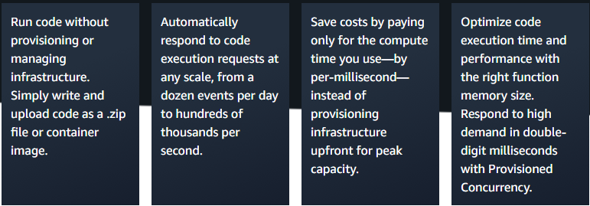
AWS Lambda

Slide 32
How it works
AWS Lambda is a serverless, event-driven compute service that lets you run code for virtually any type of application or backend service without provisioning or managing servers.
You can trigger Lambda from over 200 AWS services and software as a service (SaaS) applications, and only pay for what you use.

Slide 33
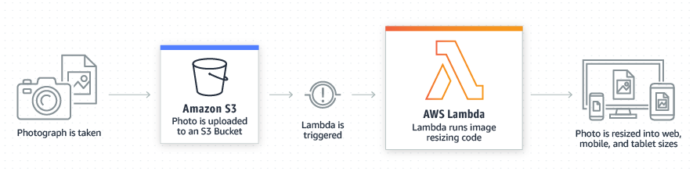
File processing
Use Amazon Simple Storage Service (Amazon S3) to trigger AWS Lambda data processing in real time after an upload, or connect to an existing Amazon EFS file system to enable massively parallel shared access for large-scale file processing.

Slide 34
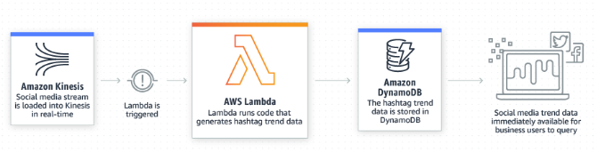
Stream processing
Use AWS Lambda and Amazon Kinesis to process real-time streaming data for application activity tracking, transaction order processing, clickstream analysis, data cleansing, log filtering, indexing, social media analysis, IoT device data telemetry, and metering.

Slide 35
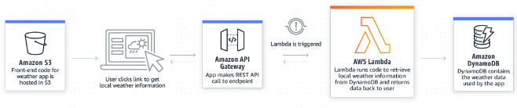
Web Applications
Combine AWS Lambda with other AWS services to build powerful web applications that automatically scale up and down and run in a highly available configuration across multiple data centers.

Slide 36
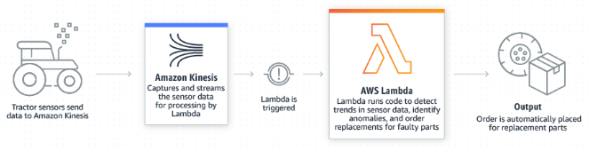
IoT Backends
Build serverless backends using AWS Lambda to handle web, mobile, Internet of Things (IoT), and third-party API requests.

Slide 37
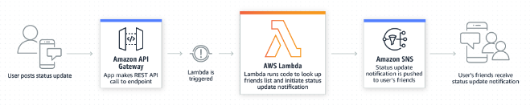
Mobile Backends
Build backends using AWS Lambda and Amazon API Gateway to authenticate and process API requests.
Use AWS Amplify to easily integrate your backend with your iOS, Android, Web, and React Native frontends.

Slide 38
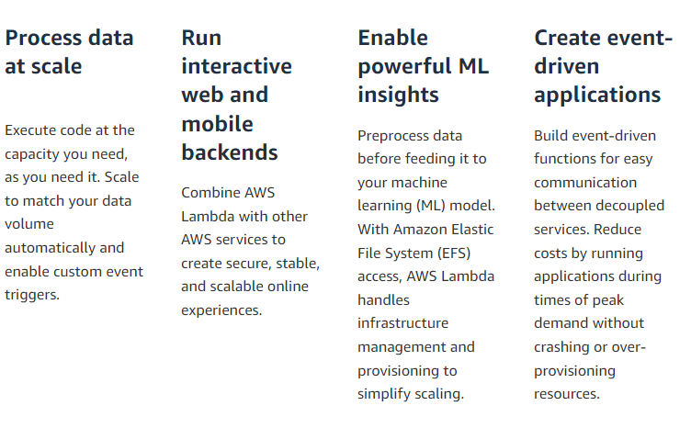
Use cases

Slide 39
Assignment
Create AWS Lambda function to:
1️⃣ Return a different message based on whether the current time is morning, afternoon, or evening. 2️⃣ Do NOT use variables (let, const, or var). 3️⃣ Ensure the message changes dynamically depending on when the function runs.
Explore creating function, deploying, editing and testing.

Slide 40
Node.js AWS Lambda function
event → Contains request data (headers, body, query params, etc.)
context → Contains function metadata (request ID, execution time left, etc.)
console.log/error/warn → Used for logging

Slide 41
Assignment:
Create a new AWS Lambda function that generates and returns a random welcome message on each execution.

Slide 42
Amazon API Gateway
Create, maintain, and secure APIs at any scale
Amazon API Gateway is a fully managed service that makes it easy for developers to create, publish, maintain, monitor, and secure APIs at any scale. APIs act as the "front door" for applications to access data, business logic, or functionality from your backend services.
Using API Gateway, you can create RESTful APIs and WebSocket APIs that enable real-time two-way communication applications.
API Gateway supports containerized and serverless workloads, as well as web applications.

Slide 43
Amazon API Gateway
API Gateway handles all the tasks involved in accepting and processing up to hundreds of thousands of concurrent API calls, including traffic management, CORS support, authorization and access control, throttling, monitoring, and API version management.
API Gateway has no minimum fees or startup costs.
You pay for the API calls you receive and the amount of data transferred out and, with the API Gateway tiered pricing model, you can reduce your cost as your API usage scales.

Slide 44
API Types
RESTful API vs. AWS API Types
RESTful API: A general architectural style using HTTP methods (GET, POST, PUT, DELETE).
AWS API Types:
REST API: Full-featured, supports authentication, caching, rate limiting.
HTTP API: Lightweight, cheaper, lower latency, fewer features.
WebSocket API: Enables real-time, bidirectional communication.
REST API (AWS API Gateway)
AWS’s legacy RESTful API with full feature support.
Supports:
IAM, API Keys, Cognito, and Lambda Authorizers.
Request transformation and validation.
Throttling, caching, logging, and monitoring.
Best for enterprise applications needing advanced API management.

Slide 45
API Types
HTTP API (AWS API Gateway)
Modern alternative to REST API, optimized for speed and cost.
Features:
Supports JWT authentication (Cognito, OIDC).
Lower cost per request compared to REST API.
Lacks advanced features like request transformation & API key support.
Best for lightweight, fast, and cost-effective APIs.
WebSocket API (AWS API Gateway)
Enables real-time, bidirectional communication.
Ideal for:
Chat applications.
Stock trading updates.
Multiplayer gaming.
Works on events instead of request-response.
Keeps a persistent connection between client and server.

Slide 46
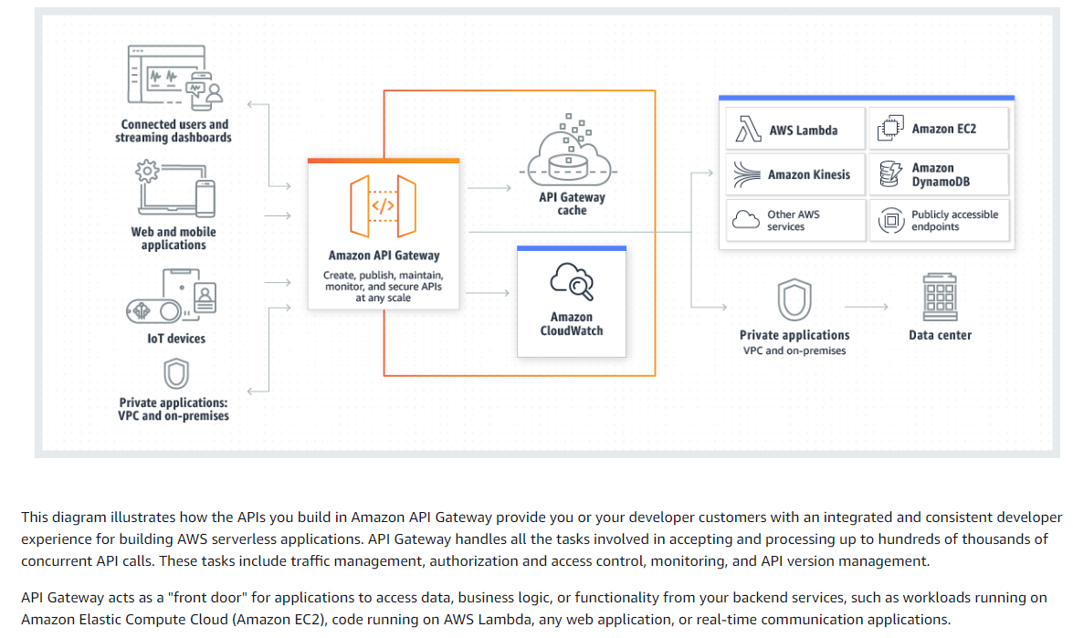
How it works

Slide 47
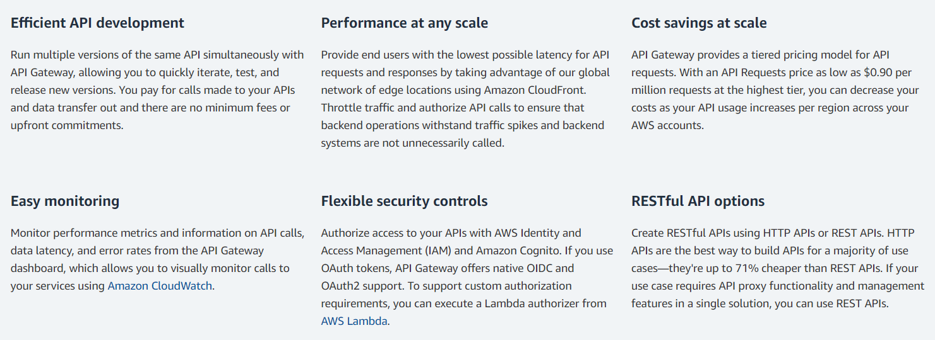
Benefits

Slide 48
Features of API Gateway
Support for stateful (WebSocket) and stateless (HTTP and REST) APIs.
Powerful, flexible authentication mechanisms, such as AWS Identity and Access Management policies, Lambda authorizer functions, and Amazon Cognito user pools.
Developer portal for publishing your APIs.
Canary release deployments for safely rolling out changes.
CloudTrail logging and monitoring of API usage and API changes.
Support for custom domain names.

Slide 49
Features of API Gateway
CloudWatch access logging and execution logging, including the ability to set alarms. For more information, see Monitoring REST API execution with Amazon CloudWatch metrics and Monitoring WebSocket API execution with CloudWatch metrics.
Ability to use AWS CloudFormation templates to enable API creation. For more information, see Amazon API Gateway Resource Types Reference and Amazon API Gateway V2 Resource Types Reference.
Integration with AWS WAF for protecting your APIs against common web exploits.
Integration with AWS X-Ray for understanding and triaging performance latencies.

Slide 50
Exercise
Create your first API Gateway
https://docs.aws.amazon.com/apigateway/latest/developerguide/getting-started.html

Slide 51
Assignment
Create new API Gateway and integrate Dynamic welcome message lambda

Slide 52
Exercise:
Build API Gateway with Rest API
https://docs.aws.amazon.com/apigateway/latest/developerguide/getting-started-rest-new-console.html

Slide 53
AWS Lambda & API Gateway: Using Environment Variables, Query Strings, and Path Parameters
Step 1: Create an AWS Lambda Function
Step 2: Add Environment Variables
Inside the Lambda function, go to the Configuration tab.
Click on Environment Variables.
Add:
DEFAULT_NAME = "Guest"
WELCOME_MESSAGES = "Hello,Welcome,Hi,Greetings,Salutations"
Step 3: Write the Lambda Function Code and deploy
Step 4: Create Test and run it

Slide 54
AWS SDK
AWS SDK for JavaScript
Develop and deploy applications with the AWS SDK for JavaScript. The SDK provides first class TypeScript support and makes it easy to call AWS services using idiomatic JavaScript APIs to build Node.js, web, and mobile web applications.
https://aws.amazon.com/sdk-for-javascript/

Slide 55
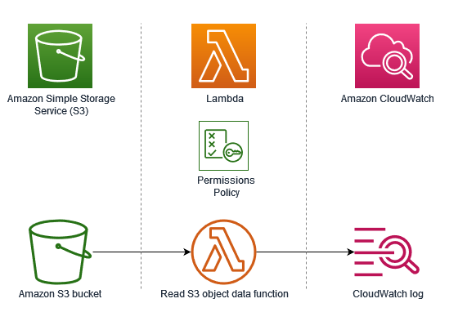
Trigger from S3

Slide 56
AWS Lambda Layer: Overview & Usage
What is an AWS Lambda Layer?
AWS Lambda Layers provide a way to manage dependencies separately from your function code. Layers allow you to package libraries, runtime dependencies, or custom code and share them across multiple Lambda functions, improving modularity and maintainability.
Benefits of Using Lambda Layers
Code Reusability: Share common libraries across multiple Lambda functions.
Reduced Deployment Size: Keep function packages small by offloading dependencies to a layer.
Simplified Updates: Update dependencies in a layer without modifying function code.
Faster Deployments: Since the layer remains unchanged, only the function code is uploaded during deployments.

Slide 57
Exercise
Fetch Weather Data Using AWS Lambda and Layers

Slide 58
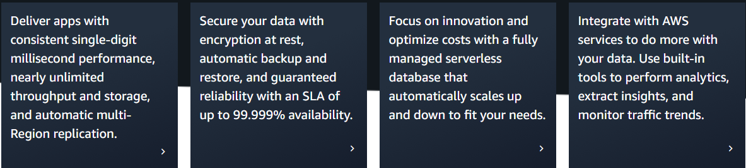
DynamoDB
Fast, flexible NoSQL database service for single-digit millisecond performance at any scale

Slide 59
DynamoDB
What is AWS DynamoDB?
Fully managed NoSQL database by AWS
Provides key-value and document data models
Designed for high performance and scalability
Supports low-latency access with automatic replication

Slide 60
DynamoDB
Key Features of DynamoDB
Managed Service: No need to manage servers
Scalability: On-demand and provisioned capacity
High Availability: Multi-AZ replication
Security: Encryption at rest and in transit
Backup & Restore: Point-in-time recovery
Integration: Works with Lambda, API Gateway, Kinesis, etc.

Slide 61
DynamoDB Architecture
Tables: Collection of items
Items: Collection of attributes (like rows in SQL)
Attributes: Data elements (like columns in SQL)
Primary Key: Unique identifier (Partition Key / Partition + Sort Key)
Indexes: GSI (Global Secondary Index), LSI (Local Secondary Index)
DynamoDB Data Model
Primary Key:
Partition Key (Single key)
Composite Key (Partition + Sort Key)
Indexes:
Global Secondary Index (GSI) – Query different attributes
Local Secondary Index (LSI) – Query with the same Partition Key

Slide 62
Capacity Modes & Pricing
On-Demand Mode: Pay per request
Provisioned Mode: Pre-define read/write capacity
Autoscaling: Adjusts based on demand
Pricing Factors: Read/write units, storage, backups, streams
DynamoDB Streams & Transactions
DynamoDB Streams:
Captures data modification events
Enables real-time event processing
Transactions:
ACID-compliant operations
Supports multiple-item atomic updates

Slide 63
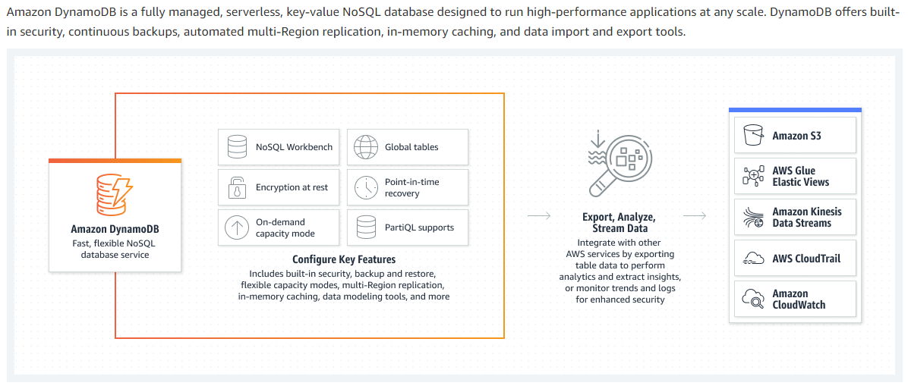
How it works

Slide 64
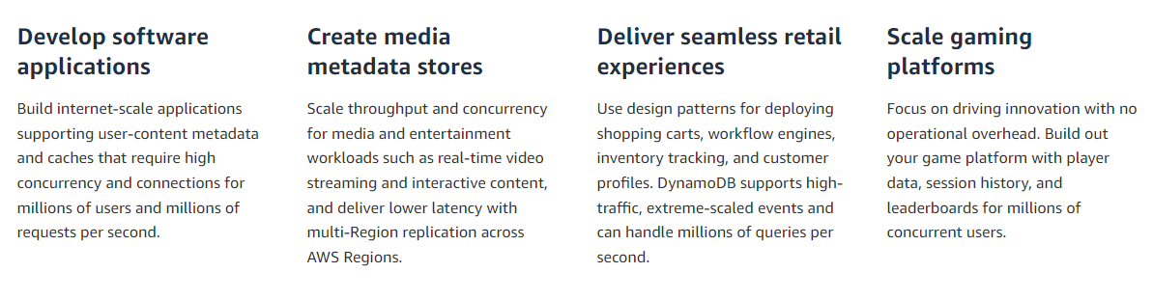
Use cases

Slide 65
Exercise
https://docs.aws.amazon.com/apigateway/latest/developerguide/http-api-dynamo-db.html

Slide 66
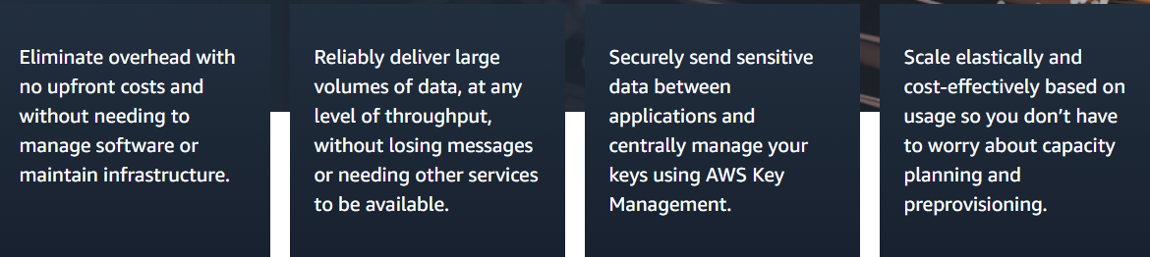
Amazon SQS
Fully managed message queuing for microservices, distributed systems, and serverless applications

Slide 67
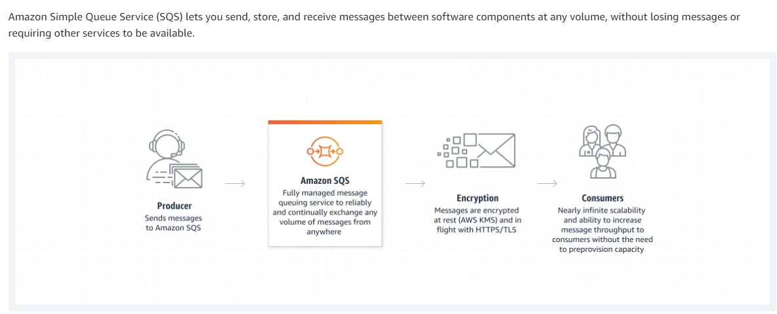
How it works

Slide 68
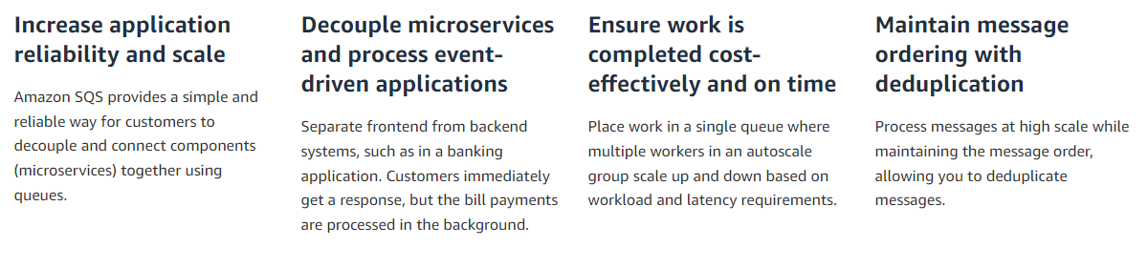
Use cases

Slide 69
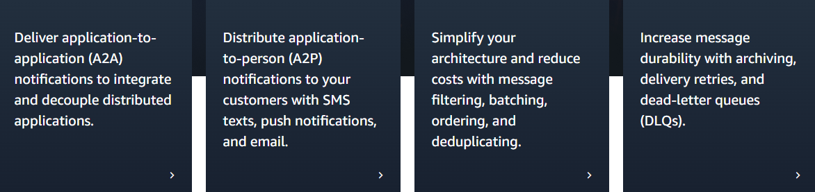
AWS SNS
Fully managed Pub/Sub service for A2A and A2P messaging

Slide 70
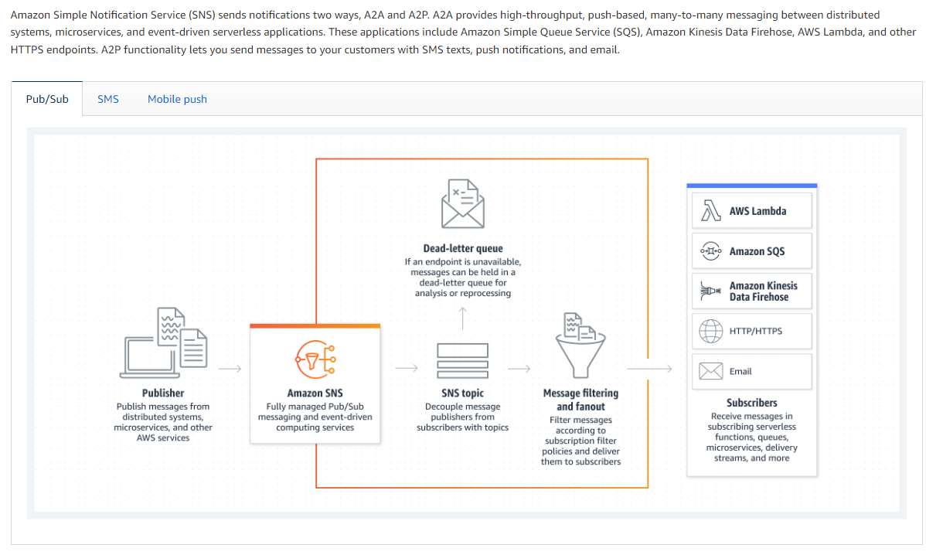
How it works

Slide 71
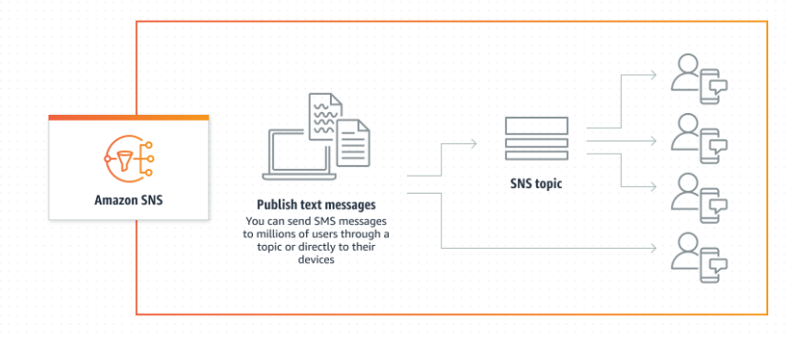
How it works - SNS

Slide 72
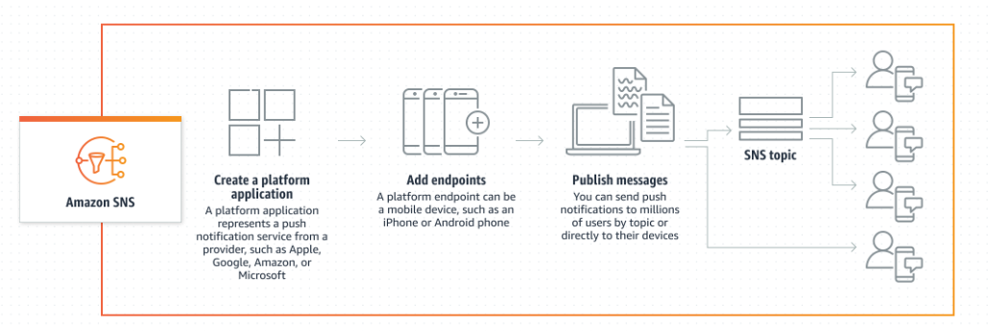
How it works - Mobile Push

Slide 73
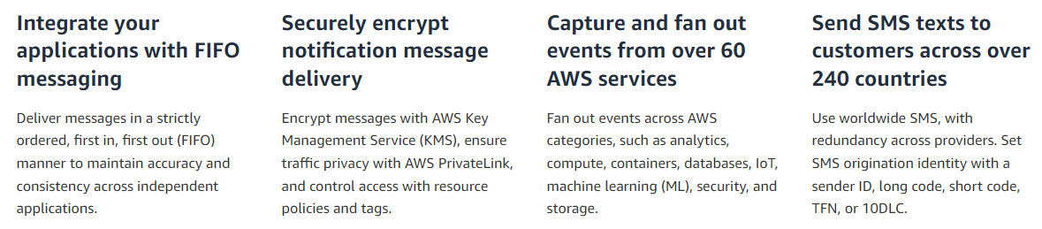
Use cases

Slide 74
AWS Step Functions Overview
AWS Step Functions is a serverless orchestration service that enables developers to design and execute workflows using state machines. It helps coordinate AWS services such as AWS Lambda, Amazon ECS, AWS Batch, DynamoDB, SNS, and SQS into scalable workflows with minimal code.
Key Features
✅ Visual Workflow Designer – Define workflows using a JSON-based Amazon States Language (ASL) and visualize them in the AWS Console. ✅ Error Handling & Retry Mechanisms – Inbuilt error handling, retries, and catch blocks. ✅ Parallel & Sequential Execution – Supports sequential, parallel, branching, and looping workflows. ✅ Integration with AWS Services – Seamlessly connects with over 200 AWS services and on-prem systems via API Gateway. ✅ Express vs. Standard Workflows – Choose Standard for long-running workflows (up to 1 year) or Express for high-throughput, short-lived executions.

Slide 75
Types of Step Function Workflows
Standard Workflows
Best for long-running processes (up to 1 year).
Supports exactly-once execution.
Ideal for human approvals, batch processing, ETL workflows.
Express Workflows
Designed for high-volume, short-duration processes.
Can handle millions of executions per second.
Ideal for real-time event processing, IoT data ingestion, microservices orchestration.

Slide 76
Common Use Cases
🔹Data Processing Pipelines – Automate ETL jobs using AWS Lambda and AWS Glue. 🔹 Microservices Orchestration – Manage dependencies and order of execution for microservices. 🔹 AI/ML Workflows – Automate ML model training and deployment with SageMaker. 🔹 Security & Compliance – Automate security checks and compliance audits. 🔹 Approval Workflows – Route approvals based on conditions and logic.

Slide 77
Example Step Functions Workflow
1️⃣ User uploads a file to S3.
2️⃣ Step Functions triggers a Lambda function to process the file.
3️⃣ The result is stored in DynamoDB.
4️⃣ A notification is sent via SNS.

Slide 78
Exercise

Slide 79
Assignment

Slide 80
AWS Kinesis Overview
What is AWS Kinesis?
AWS Kinesis is a fully managed, scalable service for real-time data streaming and processing. It allows you to collect, process, and analyze large volumes of streaming data from various sources in real time.
Key Use Cases of AWS Kinesis:
Real-time analytics: Process and analyze log data, application data, and event streams.
Log and event ingestion: Collect application logs, monitoring events, and IoT sensor data.
Machine learning data pipelines: Stream data to train and improve ML models.
Video streaming: Deliver, process, and analyze live video feeds.
Security monitoring: Detect threats in real-time using log analysis.

Slide 81
Components of AWS Kinesis
Amazon Kinesis Data Streams (KDS)
Used for real-time data ingestion and processing.
Data is divided into shards, each supporting a certain read/write throughput.
Supports consumers like AWS Lambda, Amazon Kinesis Data Firehose, and Amazon Kinesis Data Analytics.
Amazon Kinesis Data Firehose
Fully managed service for streaming data to S3, Redshift, Elasticsearch, or Splunk.
Supports data transformation using AWS Lambda before storing.
Provides automatic scaling and data compression.

Slide 82
Components of AWS Kinesis
Amazon Kinesis Data Analytics
Enables SQL-based real-time analytics on streaming data.
Supports Apache Flink for advanced stream processing.
Integrates with Kinesis Data Streams and Firehose.
Amazon Kinesis Video Streams
Used for real-time and on-demand video streaming.
Can store, retrieve, and analyze video streams using AI/ML.
Ideal for IoT, security monitoring, and media applications.

Slide 83
How AWS Kinesis Works?
Producers (IoT devices, logs, apps) send streaming data to Kinesis.
Kinesis Data Streams or Firehose ingest and process data.
Consumers (Lambda, analytics tools, storage services) retrieve and analyze the data.
Integration with Other AWS Services
AWS Lambda – Trigger event-driven processing.
Amazon S3 / Redshift – Store and analyze processed data.
Amazon CloudWatch – Monitor streaming performance.
Amazon Elasticsearch – Real-time log analysis.

Slide 84
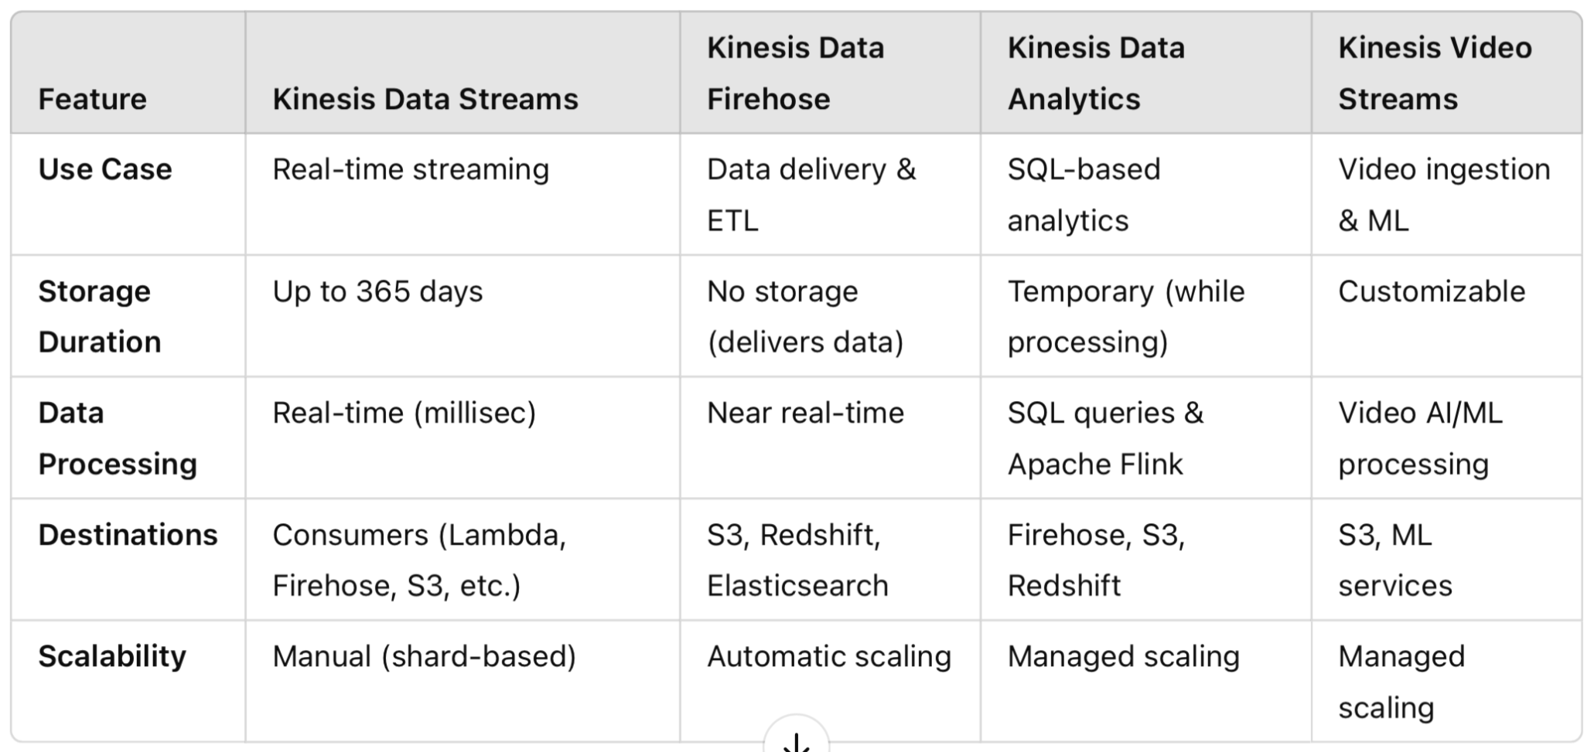
Comparison of Kinesis Services

Slide 85
Infrastructure as code
Infrastructure as Code (IaC) is an approach to managing and provisioning infrastructure in a way that treats infrastructure configurations as code.
This means that you use code, typically in a declarative or imperative language, to define and automate the setup, configuration, and management of your infrastructure, including servers, networking, storage, and other resources

Slide 86
Why Infrastructure as code
Automation: IaC automates the provisioning, configuration, and management of infrastructure, reducing manual, error-prone tasks and ensuring consistency.
Version Control: Infrastructure code can be versioned, allowing for tracking changes, rollbacks, and collaboration among team members using tools like Git.
Scalability: IaC makes it easier to scale infrastructure resources up or down based on demand, adapting to changing workloads.
Reproducibility: With IaC, you can recreate entire environments reliably, ensuring consistency between development, testing, and production.
Documentation: Infrastructure code serves as documentation, making it easier to understand and maintain infrastructure configurations.

Slide 87
Why Infrastructure as code
Collaboration: Teams can work together on infrastructure code, enabling collaboration between developers and operations personnel.
Cost Efficiency: IaC can help optimize resource allocation and reduce wastage by defining infrastructure requirements more precisely.
Security: Security policies and best practices can be codified and enforced in the infrastructure code, enhancing the security of your environment.
Portability: Infrastructure definitions can be used across different cloud providers or on-premises environments, promoting flexibility.
Change Management: IaC provides a structured approach to making changes to infrastructure, ensuring that modifications are planned and tracked.

Slide 88
Terraform
Terraform is an open-source Infrastructure as Code (IaC) tool developed by HashiCorp.
It is designed to help organizations manage and provision infrastructure resources in a declarative and automated way.
Terraform allows you to define, configure, and version your infrastructure using a domain-specific language or HashiCorp Configuration Language (HCL).

Slide 89
Why Terraform
Declarative Syntax: Terraform uses a declarative syntax to define the desired state of your infrastructure. You specify what resources you need, their configurations, and their dependencies, without specifying how to achieve that state.
Providers: Terraform supports a wide range of cloud providers (e.g., AWS, Azure, Google Cloud), as well as other infrastructure components like databases, networking, and more. These providers allow you to interact with various services and resources.
State Management: Terraform maintains a state file that keeps track of the current state of your infrastructure. This state file is used to plan and apply changes while ensuring that the desired state matches the actual state.
Execution Plans: Terraform generates an execution plan before making any changes to your infrastructure. This plan outlines what actions will be taken, such as creating, updating, or destroying resources, without applying the changes immediately.

Slide 90
Why Terraform
Modularity: Terraform encourages the use of reusable modules. Modules are a way to encapsulate and share infrastructure configurations, making it easier to maintain and standardize infrastructure setups.
Version Control Integration: Terraform configurations can be stored in version control systems like Git, enabling collaboration, change tracking, and rollback capabilities.
Community and Ecosystem: Terraform has a large and active community, and a vast ecosystem of third-party modules and plugins, making it a popular choice for IaC.
Extensibility: Terraform's extensible architecture allows you to write custom providers and provisioners to interact with specific APIs or perform custom actions.

Slide 91
Why Terraform better than other IAC tools
Multi-Cloud Support: Terraform is known for its extensive support for various cloud providers, making it a great choice for organizations that operate across multiple cloud platforms. It provides a consistent way to manage infrastructure across different environments.
HCL Syntax: Terraform uses the HashiCorp Configuration Language (HCL), which many find easy to read and write. The declarative syntax of HCL allows you to express your infrastructure requirements clearly and concisely.

Slide 92
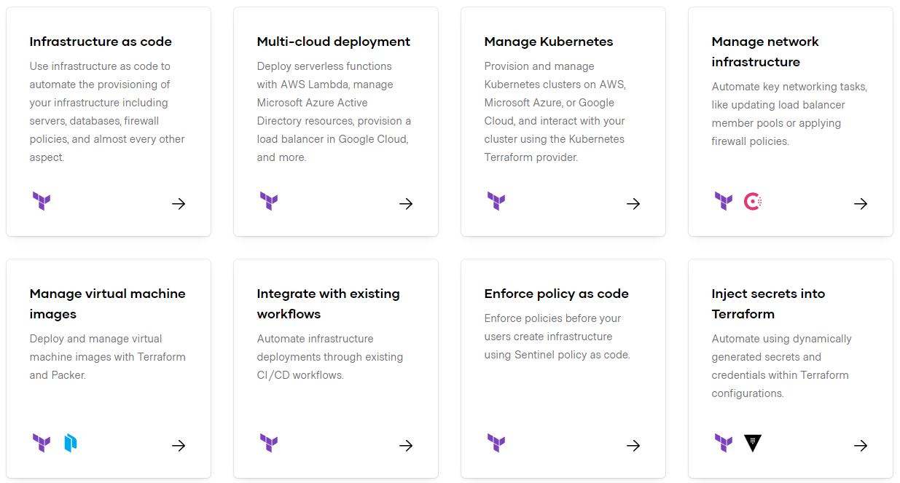
https://www.terraform.io/

Slide 93
Installation
https://developer.hashicorp.com/terraform/install

Slide 94
Exercise 1: Configure AWS CLI

Slide 95
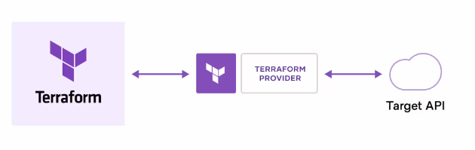
How does Terraform work?
Terraform creates and manages resources on cloud platforms and other services through their application programming interfaces (APIs). Providers enable Terraform to work with virtually any platform or service with an accessible API.
https://registry.terraform.io/

Slide 96
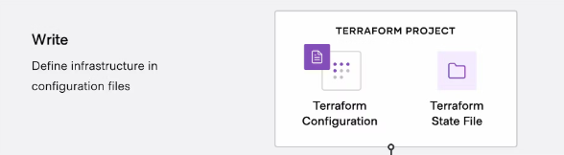
Terraform workflow stages: Write
You define resources, which may be across multiple cloud providers and services. For example, you might create a configuration to deploy an application on virtual machines in a Virtual Private Cloud (VPC) network with security groups and a load balancer.

Slide 97
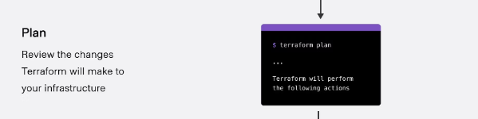
Terraform workflow stages: Plan
Terraform creates an execution plan describing the infrastructure it will create, update, or destroy based on the existing infrastructure and your configuration.

Slide 98
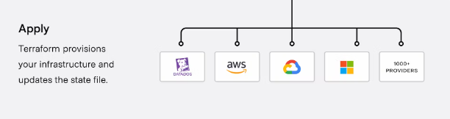
Terraform workflow stages: Apply
On approval, Terraform performs the proposed operations in the correct order, respecting any resource dependencies. For example, if you update the properties of a VPC and change the number of virtual machines in that VPC, Terraform will recreate the VPC before scaling the virtual machines.

Slide 99
Terraform HCL
HCL stands for HashiCorp Configuration Language. It is a domain-specific language (DSL) developed by HashiCorp, the company behind popular infrastructure-as-code tools like Terraform, Consul, Vault, and Packer.
HCL is used primarily for defining configurations and infrastructure in a human-readable and machine-friendly format.
HCL is designed to be easy to read and write and is used in various HashiCorp tools for defining configuration files. Some of the key features and characteristics of HCL include:
1. Declarative Syntax: HCL is a declarative language, which means you specify what you want your infrastructure to look like, and the underlying tools (e.g., Terraform) figure out how to make it happen.

Slide 100
Terraform HCL
2. Block Structure: HCL uses a block structure, with nested blocks and attributes, to define configurations. This helps maintain a clear and structured organization of configuration files.
3. Human-Readable: HCL is designed to be easily readable and writable by both humans and machines, which makes it accessible to infrastructure and DevOps engineers.
4. Variable Support: HCL supports variables, which can be used to parameterize your configuration and make it more flexible and reusable.

Slide 101
Terraform HCL
5. Interpolation: HCL allows for variable interpolation, where you can reference variables within other parts of your configuration.
6. Comments: HCL supports both single-line (`#`) and multi-line (`/* */`) comments, which are helpful for documentation and annotation.
7. Support for Multiple HashiCorp Tools: While HCL is most commonly associated with Terraform, it is also used in other HashiCorp tools like Consul, Nomad, Vault, and Packer, providing a consistent configuration language across the HashiCorp ecosystem.

Slide 102
Resources and Providers
Resources: Infrastructure components like EC2 instances, S3 buckets, databases, etc.
Providers: Plugins that enable Terraform to interact with cloud services (AWS, Azure, GCP, etc.)
Example:
provider "aws" {
region = "us-east-1"
}
resource "aws_instance" "example" {
ami = "ami-0c55b159cbfafe1f0"
instance_type = "t2.micro"
}
https://registry.terraform.io/browse/providers

Slide 103
Terraform State Files
State files track the infrastructure Terraform manages
Stored as terraform.tfstate
Helps Terraform understand the current state of resources
Allows tracking of changes between executions
Example: Terraform applies changes based on the difference between the state file and the actual cloud infrastructure

Slide 104
Desired vs. Current Infrastructure
Desired State: Defined in the Terraform configuration files
Current State: Actual deployed infrastructure
Terraform Workflow:
Write Configuration (Define desired state)
Plan (Compare with current state)
Apply (Make changes to match the desired state)
Destroy (Cleanup resources if needed)
Example: If an EC2 instance is removed from configuration, Terraform will destroy it during terraform apply

Slide 105
Terraform Basic Commands
terraform init – Initializes a Terraform working directory
terraform plan – Shows what changes will be made without applying them
terraform apply – Creates or updates infrastructure
terraform destroy – Destroys all managed resources
terraform show – Displays the current state of resources
terraform output – Extracts values from the Terraform state
terraform fmt – Formats Terraform configuration files for readability

Slide 106
Terraform Variables
What are Terraform Variables?
Terraform variables allow dynamic values in configurations.
Improve reusability, modularity, and flexibility in infrastructure management.
Defined using the variable block in Terraform.
Types of Variables in Terraform:
Input Variables (variable) – User-defined values.
Local Variables (locals) – Used within a module to simplify expressions.
Environment Variables (TF_VAR_name) – Set via the OS environment.
Output Variables (output) – Display values after execution.

Slide 107
Defining and Using Input Variables
Defining Variables in variables.tf
variable "instance_type" {
description = "EC2 instance type"
type = string
default = "t2.micro"
}
Assigning Variable Values:
Default values (inside variables.tf).
Using terraform.tfvars file:
instance_type = "t3.micro"

Slide 108
String and Number
variable "instance_name" {
description = "Name of the EC2 instance"
type = string
default = "Terraform-VM"
}
variable "volume_size" {
description = "Root volume size in GB"
type = number
default = 20
}

Slide 109
Bool and List
variable "enable_monitoring" {
description = "Enable monitoring for the EC2 instance"
type = bool
default = true
}
variable "security_groups" {
description = "List of security group IDs"
type = list(string)
default = ["sg-12345", "sg-67890"]
}

Slide 110
map
variable "additional_tags" {
description = "Additional tags for the instance"
type = map(string)
default = {
environment = "dev"
owner = "admin"
}
}

Slide 111
Object
variable "network_config" {
description = "Network configuration settings"
type = object({
subnet_id = string
assign_public_ip = bool
})
default = {
subnet_id = "subnet-abc123"
assign_public_ip = true
}
}

Slide 112
Defining and Using Input Variables
Passing via CLI:
terraform apply -var="instance_type=t3.micro"
Using environment variables:
export TF_VAR_instance_type="t3.micro"
terraform apply

Slide 113
Locals
A local value assigns a name to an expression, so you can use the name multiple times within a module instead of repeating the expression.
If you're familiar with traditional programming languages, it can be useful to compare Terraform modules to function definitions:
Input variables are like function arguments.
Output values are like function return values.
Local values are like a function's temporary local variables.

Slide 114
Locals
locals {
service_name = "forum"
owner = "Community Team"
}

Slide 115
Locals
locals {
# Ids for multiple sets of EC2 instances, merged together
instance_ids = concat(aws_instance.blue.*.id, aws_instance.green.*.id)
}
locals {
# Common tags to be assigned to all resources
common_tags = {
Service = local.service_name
Owner = local.owner
}
}

Slide 116
HCL
count:
The count parameter is used to create multiple instances of a resource.
Interpolation:
Interpolation syntax ${} is used to dynamically generate unique bucket names like my-bucket-0, my-bucket-1, etc.
It’s also used in the tags to create unique names for each resource.

Slide 117
HCL continues
depends_on:
The depends_on meta-argument is used in the aws_iam_user_policy_attachment resource to ensure the IAM user is created before attaching the policy.
Parallel Execution:
Terraform inherently runs resources in parallel when possible. The S3 buckets in my_parallel_bucket are created independently of the my_bucket buckets, showcasing Terraform's parallel execution capabilities.

Slide 118
Terraform console
This command provides an interactive command-line console for evaluating and experimenting with expressions.
You can use it to test interpolations before using them in configurations and to interact with any values currently saved in state.
If the current state is empty or has not yet been created, you can use the console to experiment with the expression syntax and built-in functions.
The console holds a lock on the state, and you will not be able to use the console while performing other actions that modify state.
To close the console, enter the exit command or press Control-C or Control-D.
$ terraform console

Slide 119
Expressions
Expressions refer to or compute values within a configuration. The simplest expressions are just literal values, like "hello" or 5, but the Terraform language also allows more complex expressions such as references to data exported by resources, arithmetic, conditional evaluation, and a number of built-in functions.
https://developer.hashicorp.com/terraform/language/expressions

Slide 120
Terraform Expressions
Expressions are used to compute values dynamically within Terraform.
They can be used in variables, resources, outputs, and modules.
Help make configurations more flexible and reusable.

Slide 121
Types of Terraform Expressions
Literal Values (Strings, Numbers, Booleans, Lists, Maps)
References (Variables, Resources, Data Sources)
Functions (Built-in Terraform Functions)
Operators (Arithmetic, Comparison, Logical)
Conditional Expressions
For Expressions

Slide 122
Exercise: Expression usage

Slide 123
Functions
The Terraform language includes a number of built-in functions that you can call from within expressions to transform and combine values. The general syntax for function calls is a function name followed by comma-separated arguments in parentheses:
max(5, 12, 9)
https://developer.hashicorp.com/terraform/language/functions

Slide 124
Functions
Terraform provides built-in functions to manipulate and compute values.
Functions help in string manipulation, numeric operations, collections, and date handling.
They make configurations more dynamic and reusable.

Slide 125
Functions
Terraform functions are grouped into the following categories:
String Functions (Manipulate text values)
Numeric Functions (Perform calculations)
Collection Functions (Work with lists and maps)
Date and Time Functions (Handle timestamps)
Encoding Functions (Convert data formats)
Filesystem Functions (Read files dynamically)

Slide 126
String Functions
Used for modifying and formatting text.
Examples:
upper("hello") → "HELLO"
lower("HELLO") → "hello"
length("terraform") → 9
replace("Terraform", "form", "ing") → "Terraforming"

Slide 127
Numeric Functions
Used for mathematical operations.
Examples:
abs(-10) → 10 (Absolute value)
max(5, 10, 3) → 10 (Largest number)
min(5, 10, 3) → 3 (Smallest number)
floor(3.8) → 3 (Round down)
ceil(3.2) → 4 (Round up)

Slide 128
Collection Functions
Used for working with lists and maps.
Examples:
length(["apple", "banana", "cherry"]) → 3
join(", ", ["AWS", "Azure", "GCP"]) → "AWS, Azure, GCP"
lookup({name="Terraform", type="IAC"}, "type", "unknown") → "IAC"
contains(["t2.micro", "t3.medium"], "t3.micro") → false

Slide 129
Date and Time Functions, Encoding Functions
Used for handling timestamps.
Examples:
timestamp() → "2025-03-04T12:00:00Z" (Current UTC time)
timeadd(timestamp(), "24h") → "2025-03-05T12:00:00Z" (Add 24 hours)
Used for formatting and encoding data.
Examples:
jsonencode({name="Terraform", version="1.5"}) → '{"name":"Terraform","version":"1.5"}'
base64encode("hello") → "aGVsbG8="

Slide 130
Filesystem Functions
Used to read files dynamically.
Examples:
file("config.json") → Reads file content
templatefile("user-data.tftpl", {name="Arjun"}) → Uses a template file

Slide 131
Data Sources
Data sources allow Terraform to use information defined outside of Terraform, defined by another separate Terraform configuration, or modified by functions.
data "aws_ami" "example" {
most_recent = true
owners = ["self"]
tags = {
Name = "app-server"
Tested = "true"
}
}

Slide 132
Terraform Modules
A module is a container for multiple Terraform resources that are used together.
Modules help in organizing, reusing, and maintaining Terraform code efficiently.
Every Terraform configuration implicitly forms a module (root module).
📌 Why use Modules?
✅ Code Reusability
✅ Easier Maintenance
✅ Improved Scalability
✅ Enforces Best Practices

Slide 133
Module structure
A Terraform module typically consists of:
main.tf – Defines resources
variables.tf – Defines input variables
outputs.tf – Defines output values
/terraform-aws-s3
├── main.tf
├── variables.tf
├── outputs.tf
├── README.md

Slide 134
Exercise
Terraform without modules
Terraform with modules
Assignment
Access public modules

Slide 135
Exercise: Terraform functions

